Slide 1


Quasi-definitive Data Compliance 2017
Andrew Lewis
Notes:
An IMO action item from the Ottawa meeting called for a compliance study of the 2017 quasi-definitive data set to see how well the QD data are performing and to publish results of that study in a presentation at the Kazan IAGA workshop. That Kazan workshop has been cancelled but I will take this opportunity to present the results here.

Slide 2
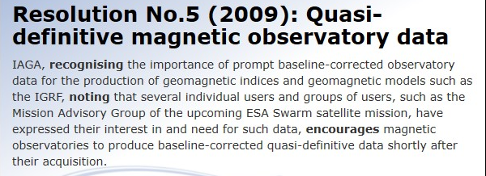
Brief History of Quasi-definitive Data -1
2007
Beijing: Initial suggestion by Arnaud Chulliat (ex-EXCON) to support the ESA SWARM satellite mission
2008
INTERMAGNET Discussion Document DD9
2009
IAGA Resolution No 5 (2009)
2011
First submissions of quasi-definitive data
Notes:
I think it is worth quickly recapping the history of QD and I have made a quick summary over the next two slide. Many of you will know more on this subject than I do
In 2007 former EXCON member, Arnaud Chulliat, identified the need for timely high quality data to support the magnetic field modelling coming out the satellite missions such as SWARM. Quality data were required in a faster time-frame than the traditional definitive data which can be delayed by 12 months or more.
In 2008 Arnaud wrote an INTERMAGNET Discussion document to formalise the case for QD data and in the following year IAGA resolution No 5 was endorsed to encourage all observatories to produce QD data.
2011 was the first year for QD data. The blue line on the plot shows the number of times the word “Quasi-Definitive” was mentioned in the minutes of INTERMAGNET meetings since 2007. It shows the large amount of work required to develop the infrastructure and standards required to get QD data flowing.
The orange line show the number of IMOs contributing QD data since it first started in 2011. The number rose rapidly from 20 to around 70 IMOs where is has stabilised for several years.

Slide 3
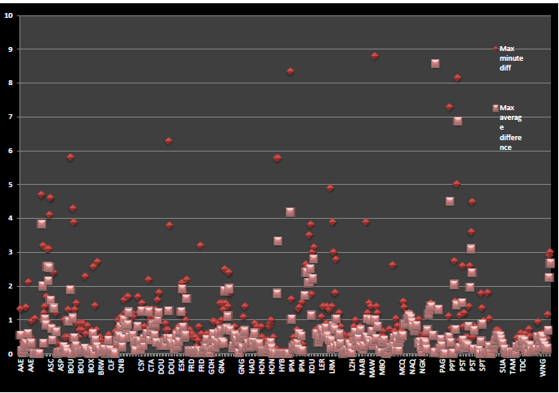
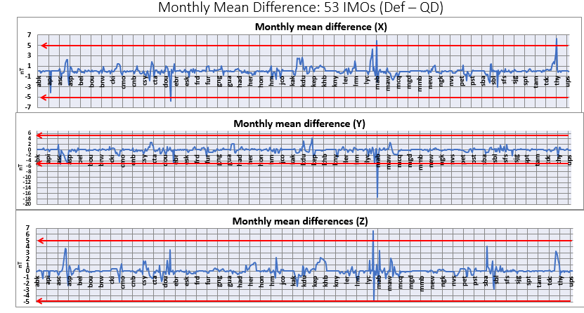
Brief History of Quasi-definitive Data -2
2014 Hyderabad:
2012 Quasi-definitive data comparison
40 contributing IMOs, 2 non compliant
2018 Vienna:
2015 Quasi-definitive data comparison
53 contributing IMOs, 5 non compliant
Notes:
In the Hyderabad meeting there was a Comparison study presented on the 2012 QD data set. In that study, of the 40 contributing IMOs 2 were found to have non-compliant data.
A similar study was presented in 2018 using the 2015 QD data set when 5 of the 53 contributing IMOs had non-compliant data.

Slide 4
Quasi-definitive Data
http://www.intermagnet.org/faqs-eng.php#quasi-definitive
INTERMAGNET has defined a standard for a new data type called quasi-definitive. As the name implies the data should be close to the expected definitive value, but is to be delivered more rapidly than an observatories annual definitive data. This initiative will be useful for a number of scientific activities, but with the Swarm satellite mission near its start date, the data will be particularly useful in providing ground truth data for the satellite’s magnetometers.
Quasi-definitive data are (H, D, Z) or (X, Y, Z) 1-minute data:
Corrected using temporary baselines
Made available less than 3 months after their acquisition
Such that the difference between the quasi-definitive and definitive (X, Y, Z) monthly means is less than 5 nT for every month of the year
Point c is checked a posteriori by comparing quasi-definitive and definitive data from the previous year.
Notes:
We are all familiar with the definition of QD data but here is a quick reminder. The two testable parameters are highlighted bold.
Data should be published within 3 month of acquisition
The difference between Definitive monthly means and quasi-definitive monthly means must be less than 5 nT

Slide 5
2017 Quasi-definitive Data
72 IMOs submitted at least some 2017 QD data
ABK, API, ASC, ASP, BEL, BFO, BOU, BOX, BRW, CKI, CLF, CMO, CNB, CSY, CTA, CYG, DLT, DOU, EBR, ESK, EYR, FRD, FRN, FUR, GDH, GNG, GUA, HAD, HER, HLP, HON, HRN, IPM, JCO, KAK, KDU, KEP, KHB, KNY, KOU, LER, LRM, LYC, LZH, MAB, MAW, MBO, MCQ, MGD, MMB, NAQ, NEW, NGK, NVS, PET, PHU, PST, SBA, SBL, SFS, SHU, SIT, SJG, SPT, SUA, TAM, THL, THY, TUC, UPS, VNA, WNG
3 of these 72 IMOs had no 2017 definitive data available (2020-01-29)
DLT, IPM, SJG
Data from 69 IMOs available for this comparison
Differences calculated using “QDC” written by Peter Crosthwaite. Code available at: https://github.com/INTERMAGNET/QDC
Notes:
In 2017 I found 72 IMO had contributed QD data – the list of IMOs is shown here in green
At the time I downloaded the data sets three of those IMOs had not completed their 2017 Definitive data – hence there are 69 IMOs including in this study.
Just like the previous two QD data comparisons, I have used the QDC - “Quasi Definitive Compare” software. That software is now available on an INTERMAGNET github repository.

Slide 6
2017 QD % Availability: 69 IMOs
Notes:
This shows the % data availability of 2017 QD data for each IMO in the study
The bottom plot is the same data zoomed-in to highlight the 80 to 100 % range and shows that the majority of IMOS had well over 95% availability of data

Slide 7
2017 Annual Mean Difference: 69 IMOs (Def – QD nT)
Notes:
This slide shows differences in annual means between Definitive and QD. While annual differences are not part of the QD definition, it is a useful quick-look parameter to identify problems and gives a synoptic over-view of data quality.
These plots show differences of annual means (Definitive data – Quasi-definitive data) for the X, Y and Z components on a scale of +/- 5 nT
It gives a quick indicator of data that may be out of compliance

Slide 8
2017 Min. and Max. Minute Difference: 69 IMOs X (North) nT
Notes:
This slide shows the maximum and minimum differences between Definitive and QD data. The slide shows the X component.
Both plots show the same data but the lower plot is zoomed to show detail in the +/- 20 nT range. The top plot has a range of +/- 2000 nT
It is likely the peaks in these plots could be caused by a single one-minute spike in QD data that was later identified and corrected in the Definitive data.

Slide 9
2017 Min. and Max. Minute Difference: 69 IMOs Y (East) nT
Notes:
Similar data for the Y component – It is not surprising to me that those IMOs with larger values are often at the higher latitude locations.

Slide 10
2017 Min. and Max. Minute Difference: 69 IMOs Z (Vertical) nT
Notes:
This is the maximum and minimum values for the Z component.

Slide 11
2017 Monthly Mean Difference: 69 IMOs (Def – QD)
Notes:
This is the monthly mean differences and these data directly address the +/- 5 nT
quality criteria for QD data.
The X Y and Z component are shown. The black line is made up of the monthly difference data for each IMO.
The horizontal red lines highlight the +/- 5 nT limit. If the black line is above or below the red lines then that month of data is non-compliant.
The large majority of data lies well within these limits but there are a small number of IMOs with some data beyond the 5 nT limit
.
Tihany (Hungary), Apia (Western Samoa), Jim Carrigan Observatory (northern Alaska) and Manhay (Belgium)

Slide 12
Notes:
These plots show the distribution of the monthly differences of the X Y and Z components.
They are mostly clustered around 0 nT.

Slide 13
Out of Specification
X Channel |  | Y Channel |  | Z Channel
IMO | Month | IMO | Month | IMO | Month
 |  | API | May=7.5
 |  | JCO | Mar=5.4
 |  |  |  | MAB | Mar=5.6 Apr=6.1 May=5.7 Jun=5.8 Jul=6.2 Aug-6.4
THY | Mar= 80.9 Apr= -20.4 Jun=-7.6 | THY | Mar=93.9 Apr=-18.2 May=9.3 Jul=-26.0 Aug=-24.6 Sep=-20.5 Oct =-18.0 Nov=-18.8 Dec=-19.6 | THY | Mar=22.1 Apr=-44.5 Jun=6.4
Notes:
This table summarised occurrences of non-compliant data.
In the X channel, Tihany has three months of data, some of these with significant differences.
For the Y channel, Apia and Jim Carrigan Observatory each have one month and Tihany has 9 months
For Z channel, Manhay has 6 months just sneaking over the threshold and Tihany has three months.

Slide 14
Notes:
Looking in more detail at those 4 IMOs I have plotted daily differences between Def and QD for X, Y and Z
Here for API and JCO.
The May QD data for API was very strange and I suspect there was possibly an error with the file submissions. All API data were submitted as XYZ data except for about half of May which was provided in HDZ. The Y difference of that data were up around 10 nT.
For JCO there were two months in the Y component just sneaking over the 5 nT limit with the remainder of the year well within the limit.

Slide 15
Notes:
Similar plots for Manhay and Tihany.
For Manhay X and Y are very good but there is a sustained offset over 5 nT in the Z component. The behaviour of the data in December looks unusual to me with more scatter in the daily differences at the end of the year.
For Tihany there are some quiet large daily difference in March and April and some smaller offsets later in the year.
For Tihany I have also zoomed in to see more detail on the next slide.

Slide 16
Notes:
With a range of +/- 20 nT and the red lines showing the 5 nT limit.
A significant proportion of the THY data is good.
The THY Definitive data look very nice so I believe the problem lies in the QD data.

Slide 17
Publication Delay
“Publication Date” is an optional field in the IAGA-2002 meta-data header.
Some, but not all, IAGA-2002 daily QD file include “Publication Date”.
At this time, the only alternative, available for all data files, is the operating system file modification date.
This is available for all QD daily files and was preserved during FTP data transfers. The OS file modification date correlates with IAGA-2002 header “Publication Date” for those files checked.
OS file modification date was used as the measure of the publication date for the QD data for all IMOs.
Data acquisition date was obtained from the IAGA-2002 daily file name eg “CLF20170416qmin.min”
>90 days was used as an approximation of the “three months” delay time
Notes:
So that brings us to the second criteria, which is timeliness of data delivery.
The Publication delay for QD data should be less than three months.
During the last study made on the 2015 data, we discovered there is no 100% reliable way to test this parameter with our current systems and I think that is still the case for the 2017 data.
Information on publication date can be included in daily IAGA-2002 headers as an optional record but is not available in all files. Data handled through the EDI GIN include this information, but other GINs do not include the publication date in the meta data.
The only alternative I could think off which is available for all data is the operating systems file modification date – this is preserved across FTP files downloads and agreed with the IAGA-2002 publication date info published for this Edi-GIN data I tested.
We saw last time this method does have some problems but I have done the analysis anyway as I think it does provide some useful information.

Slide 18
89 % delivered before 90 day delay (including Kyoto GIN)
11 % delivered after 90 days delay
> 365 days API; EYR; BFO: [ASC; KEP; MAW; NAQ; PST; SBL]
Notes:
The top plots shows the distribution of the publication delay for the 24000 QD daily data files.
The red vertical arrow highlights the 3 month delay. The majority of data lie to the left of that arrow and so were delivered before the three monthly limit. To the right of the vertical arrow represents data delivered after the three-month limit.
The peak around 180 days is from IMOs who provide data through the Kyoto GIN. It does not actually represent late data, but is a result of the very thorough process used by the Kyoto GIN to deliver data into the archive where each data file is delivered multiple times over a six-month period and as a result, the file modification date in the archive represents the last time the file was delivered, rather than the first time.
In the percentages shown below, this block of data from the Kyoto GIN have all been considered as on time deliveries, but there is no way to tell if they are on time or late using this methods I am using.\
The peak at far right represents data published after more than 1 year. Those IMOs contributing to that peak are listed - The bulk of this contribution is from the first three IMOs. The other IMOs listed in brackets contribute only a small handful of days.
The bottom plot shows the same data but attributed to each IMO individually The horizontal red arrow highlights the three monthly limit.
Labels on the horizontal axis for this plot are indicative only - there are not consistently 365 days of data available for all IMOs the labels are slightly out of phase.
89% of the QD data were delivered before the deadline (including the IMOs passing through the Kyoto GIN).
Only 11% of data files were delivered after the three-month deadline.

Slide 19
Summary
Monthly Mean Difference
A total of 23 months from 4 IMOs have monthly mean differences outside the +/- 5 nT limit, representing 3% of the 808 months of QD data available in 2017
Publication Delay
11% daily QD files were delivered late (more than three months after acquisition
Publication delay cannot be accurately monitored.
This situation could be improved if GINs included the optional “Publication Date” record in the IAGA-2002 meta-data header when uploading QD data to the INTERMAGNET archive.
Notes:
In summary there was a total of 23 months of data from 4 IMOs which have monthly mean differences outside the +/- 5 nT limit.
This represents 3% of the 808 months of available data
11% of the daily IAGA-2002 files were delivered after the three-month publication delay. The publication delay cannot be measured with 100% confidence. This could be improved using the system available currently if all GINs added the optional “Publication Date” as a meta-data header parameter in the daily IAGA-2002 format QD data files when uploading data to the INTERMAGNET archive.

